Slide 1
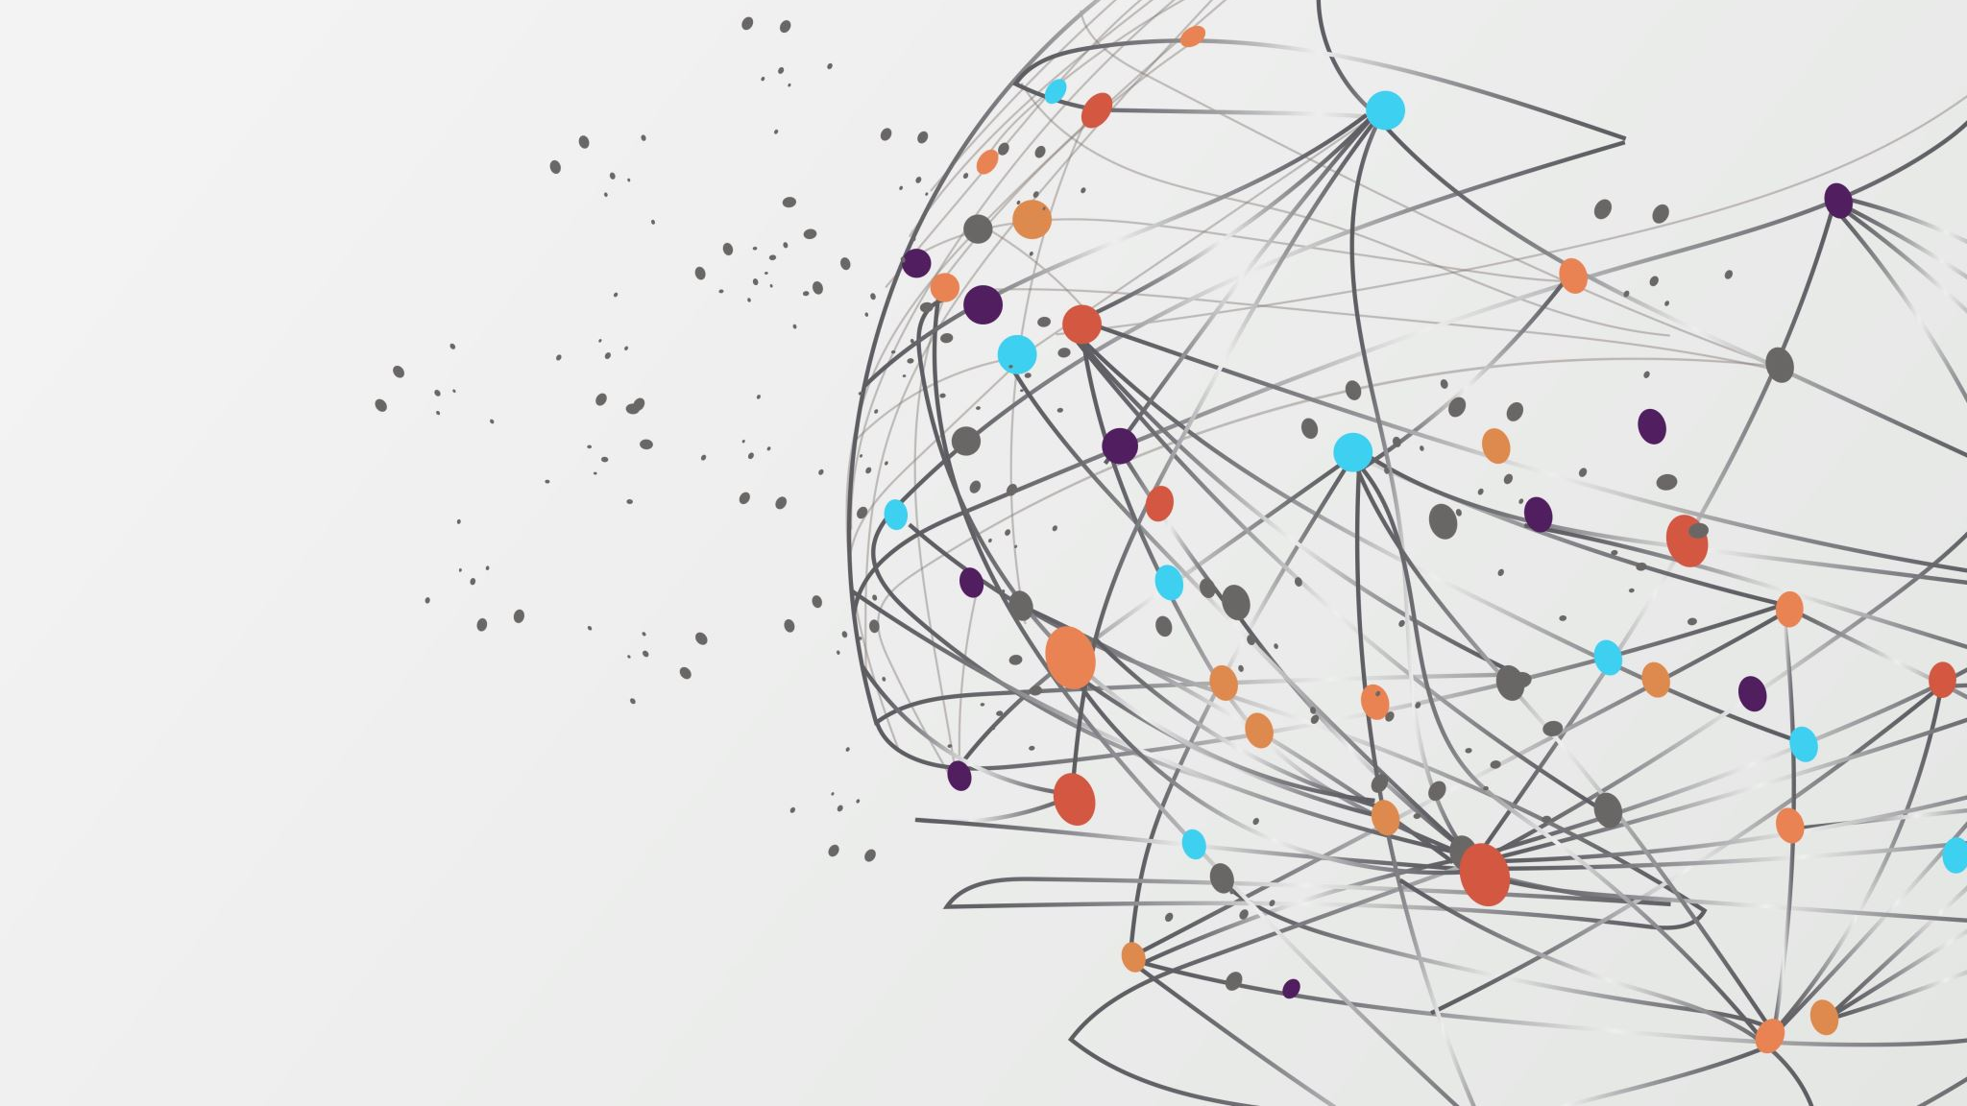
Quran Recitation Recognition & Interactive learning of Quran recitation
By: Rahma Hassan

Slide 2
Presentation Flow:
1-Introduction
2-Problem Definition
3-Motivation
4-Challenges
6-Feature extraction techniques
7-MFCC
8-Literature Review
9-Conclusion
10-References

Slide 3
Introduction
Holy Quran is divine book for Muslims, and it is very important for them.
Quran has some rule (Tajweed) which should be followed to recite Quran properly.
People need to learn how to recite Quran correctly.

Slide 4
Automatic speech recognition
ASR is a process which computer takes voice and transform it to words for specific purpose.

Slide 5
Tajweed
Set of rules, like where to stop and for how long, when to merge two letters in pronunciation ,etc.
Essential in reading Quran
Different reading might give different meanings.

Slide 6
Motivation
Help Muslim Arabs in Reading Quran accurately
Many Muslims are not Arabic native speakers and need to learn Quran.
Traditional methods (face to face learning) is not enough .
-Needs expert Quran Teachers.
-Problems in the environment(surrounding noise/lack of attention)
-Learning Sessions with Quran Teacher has limited time.
Facilitate Quran recitation using software applications on our Smartphones .

Slide 7
Challenges
1-Arabic language Challenges.
2-Quran Rules ‘Tajweed’’ Challenges.

Slide 8
Whole Speech Recognition Process
Collecting Data
Data Preprocessing
Feature extraction
Feature classification

Slide 9
Feature Extraction techniques
Perceptual Linear Prediction (PLP).
Linear Predictive Coding (LPC).
Mel-Frequency Cepstrum Coefficients (MFCC).
Linear Prediction Cepstral Coefficients(LPCC).
Discrete Wavelet Transform (DWT).
Linear Discriminant Analysis (LDA).

Slide 10
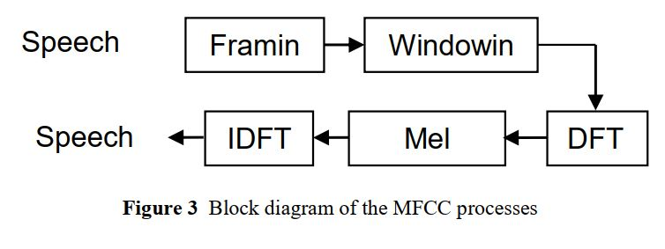
MMFC structure

Slide 11
Features classification techniques
1) Acoustic Phonetic Approach
2) Pattern Recognition Approach
3) Artificial Intelligence Approach

Slide 12
Literature Review
-Development of Quranic recitation Systems have increasing importance
-Many Papers exist in topic ‘Quran Recitation Recognition’
-In addition, Some software applications exist like ‘Tarteel application’.

Slide 13
Paper:1 SMARTAJWEED AUTOMATIC RECOGNITION OF ARABIC QURANIC RECITATION RULES
By: Ali Alagrami (Department of Computer Science, University of Venice) and Maged Eljazzar (Faculty of Engineering, Cairo University, Egypt).
Published 2020.
The main purpose is to recognize different rules of Tajweed in audios.
Improve existing tools for Tajweed learning.
The whole process is applied in ‘Imam’ app in its beta version too.
The purpose was building system that can generally recognize the rule in any verse of Quran.
They proposed a tool for recognition of 4 rules of Tajweed (Edgham Meem, Ekhfaa Meem, tafkheem Lam, Tarqeeq Lam)
Data collected from Volunteers and paid Specialists.
Data contains right and wrong ways for the pronunciation.

Slide 14
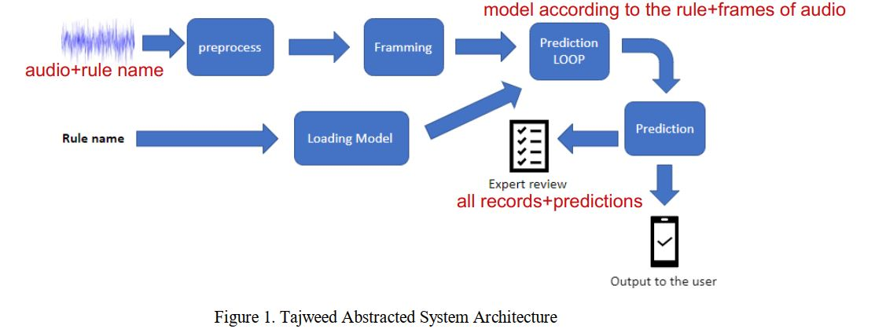
The whole system:

Slide 15
Paper 1-Dataset & Processing
Input : audios along with name of rule.
Dataset : 80 record for each Rule name and type with a total of 657 recordings of 4 different rules.
To increase data: They used data(recordings) from users of the app in its beta version ,reviewed by experts.
This improves the model.
All files is cut to contain the ‘rule’ only.
The length of all files becomes 4 seconds as the average length of audio files
-silence added.
-file truncated randomly.

Slide 16
Paper1: Feature extraction & Classification
Feature extraction(Filter banks applied):
1-Signal are cut to frames(each frame is 25ms)
2-Hamming window applied to decrease noise.
3-FFT to get spectrum.
Classification Model:
-Support Vector Machine (supervised machine learning algorithm)
-hyperparameters: C (Regularization parameter) 🡪1 , gamma 🡪.1

Slide 17
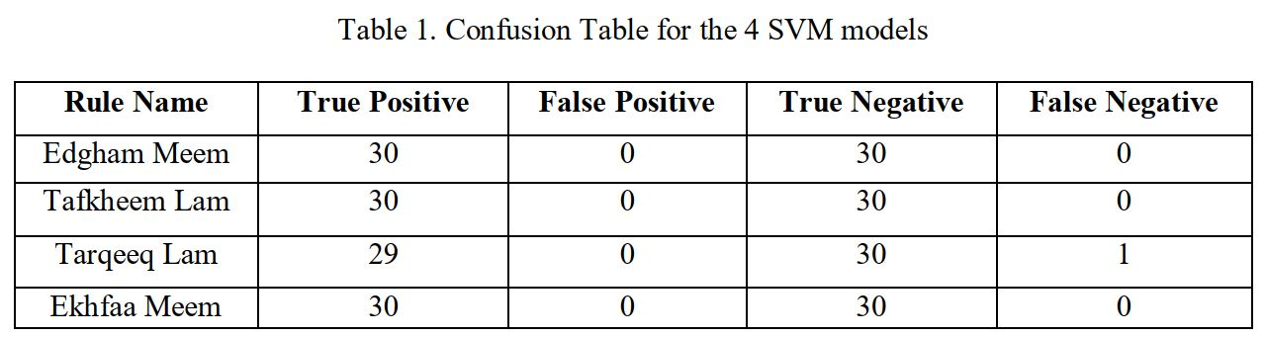
Paper 1:Results
Each model(there are 4 models) in the system tested against 30% of the Data with a validation accuracy of 99%
Then ,the whole system tested against full verses to extract rules.
System not recognize rule only but also get accurate timing in which the rule is started and ended.
The problem is treated as a normal binary classification problem.
Goal🡪 include more recitation rules in the app (IMAM app).

Slide 18
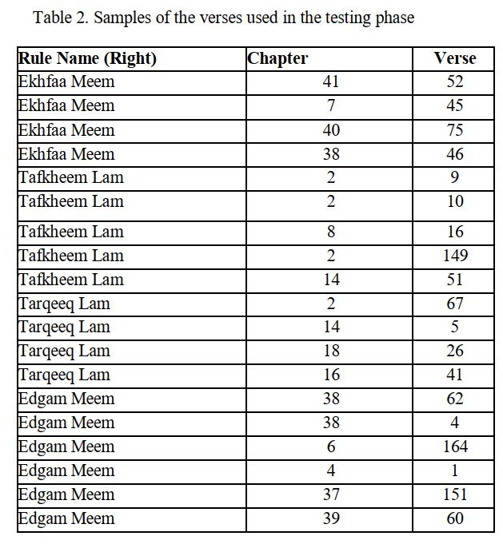
TESTING

Slide 19
Paper 2: E-Hafiz: Intelligent System to Help Muslims in Recitation and Memorization of Quran
Hafiz :person who knows Quran very well and can correct with Tajweed rules and can correct mistakes for others.
The E-Hafiz app detect wrong recitation and notify user but doesn’t recognize recitation rules ’Tajweed’
Authors :
Dept. of CS & E, University of Engineering & Technology, Lahore. Department of Computing and Technology, IQRA University, Islamabad, Pakistan. Dept. of CS, CINVESTAV-IPN, D.F. Mexico.
Extract Features of recordings using MFCC.
Compare users’ recitations and experts’ recitations.
Any mismatch between expert recitation and recordings is pointed out for user to correct it.
System can detect mistakes on word level.
If mistake found ,system gives option to user to listen the verse again from stored recitations and read and record it again like what happens in real life.

Slide 20
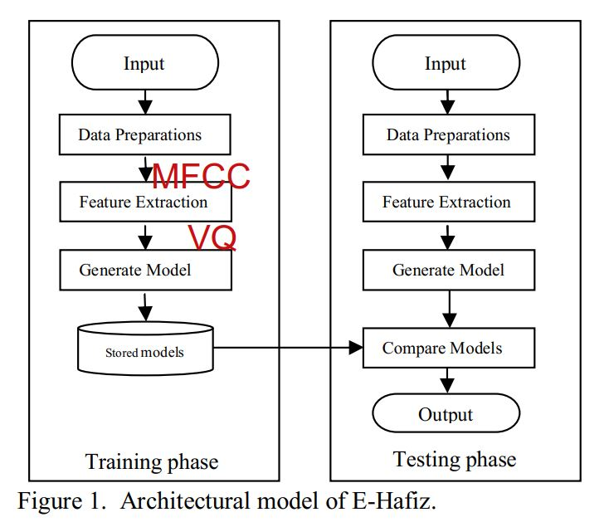
Paper 2 : (Architecture)
Features vectors are big so they reduced by getting most representative vectors by VQ.
Vector Quantization is the data compression technique.
Each set of vectors are clustered.
So, in every cluster there is a mean value called the code vector of that cluster.
All code vectors in all clusters is called a codebook.
Features Reduction.

Slide 21
Paper 2: (whole process)
1. Gets record of a selected verse recited by users. 2. Make processing on it by extracting the words in the record.
3. Extract features of each word using MFCC 4. Generate codebook of these recorded words and form array represents whole verse. 5. Make the same thing in database by extracting codebooks array of same verse recited by experts. 6. Compare Expert’s codebook array and user’s codebook array of each word, compute averages, calculate distance between them. 7. Resultant distance value compared with Threshold value. Determine matching or mismatching.

Slide 22
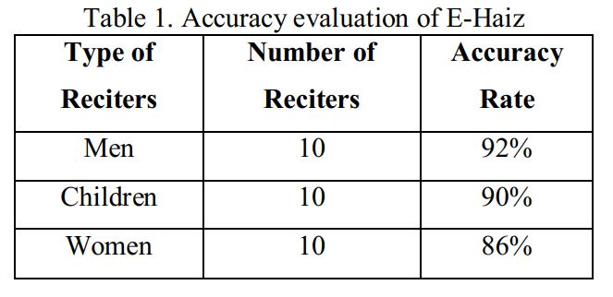
Paper 2: (Results & Future work)
Results 🡪 Three groups of reciters men, women and children are chosen in experiment.
Candidates recites verses in front of Quran experts along with E-Hafiz app.
Results of E-Hafiz compared by Hafiz person to determine accuracy of E-Hafiz.
Future work 🡪To make Recognition on the level of letters so a miss pronunciation of a letter of can be identified.

Slide 23
Paper 3:Using Deep Learning for Automatically Determining Correct Application of Basic Quranic Recitation Rules
Authors: Mahmoud Al-Ayyoub, Nour Alhuda Damer, and Ismail Hmeidi Jordan University of Science and Technology, Jordan
Published:2018
Special paper because…It addresses the problem of identifying the correct usage of Ahkam Al-Tajweed in the entire Quran. focus on eight Ahkam Al-Tajweed.
The goal is to extract as few features as possible without affecting the accuracy of the system.
Feature Extraction: traditional & non-traditional techniques. for the non-traditional type, Convolutional Deep Belief Network (CDBN).
CDBN: [get spectrogram, PCA, training of layers by filters, output models from training processes used to extract out the features from dataset, calculate mean and SD].

Slide 24
Paper 3: Classification Techniques
1-Nonlinear ML Algorithms (use one-layer processing) : KNN
SVM
ANN
2-Ensemble ML Algorithms Random Forest Multiclass Classifier Bagging

Slide 25
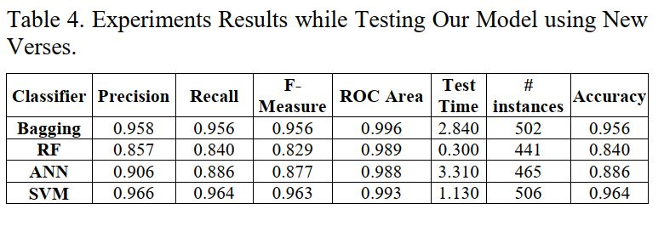
Paper 3: (Results)
CDBN can get more accurate results in feature extraction since good classifications depend on the best features obtained.
This combination , (MFCC features, WPD features, mean of HMM-SPL features and features using CDBN) gives better results in feature extraction.
Results prove that model can identify the recitation rule in a verse on which it is not trained with 96.4% accuracy.
Best results can be obtained by using MFCC, WPD, HMM-SPL and CDBN for feature extraction and SVM for classification. (506 out of 525 instances classified correctly) .

Slide 26
Paper:4 Towards Using CMU Sphinx Tools for the Holy Quran Recitation Verification
Uses: Carnegie Melon University (CMU) Sphinx which is a statistical speaker-independent set of tools using the Hidden Markov Models (HMM).
CMU used 🡪 train and evaluate a language model on Quran recitations
Published:June,2016
An acoustic model is used in automatic speech recognition to represent the relationship between an audio signal and the phonemes or other linguistic units that make up speech
Used before by many researchers for Arabic speech recognition.
They focus using of a simplified set of Arabic phonemes instead of the Romanized set of phonemes.
Acoustic model needs 🡪 transcription file, phonetic dictionary, set of phonemes, audio files.

Slide 27
Paper:4 Data
Recordings of verses of chapters (1,112,113,114).
Choosing chapters (1,112,113,114) because they contain few set of Tajweed rules.
Recordings converted to 16 kHz,16 bit.
Some manual processing needed like cutting the beginning and ending of files.
Used small set of audio files during the training phase.

Slide 28
Paper:4 (Results and discussion)
Good accuracy in Recognition.
Word Error Rate 🡪 lower than 2% in many configurations and settings.
Min Word Error Rate (1.5%).
Future Work:
Include more chapters, include more recitation recordings to increase data set.

Slide 29
Paper 5: MFCC-VQ APPROACH FOR QALQALAH TAJWEED RULE CHECKING
System for Qalqalah checking
Published:2014
The purpose is to help students read Quran properly.
Feature Extraction and Classification Technique: hybrid MFCC-VQ architecture.
MFCC needs high computational time.
Overall real-time factor using hybrid MFFC-VQ was faster than traditional method using MFFC.

Slide 30
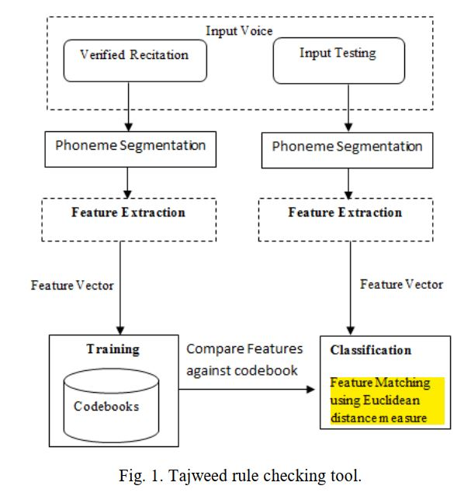
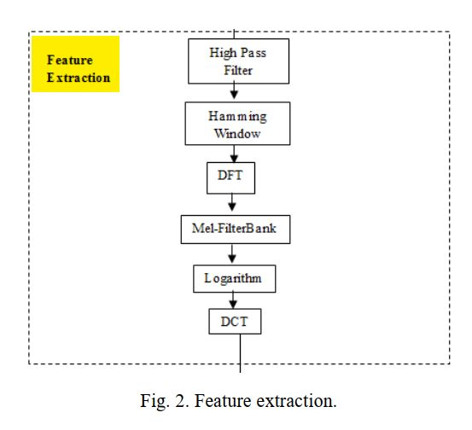
Paper 5:
-Training data stored(data base),tested data compared by reference data.
-Feature Extraction 🡪 MFCC

Slide 31
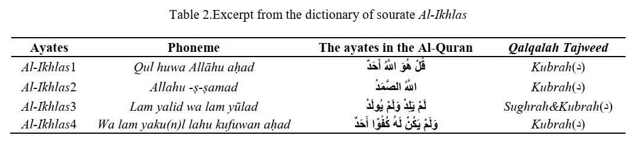
Paper 5: (Data)
45 speakers ,20 males, 20 females and 5 children.
sourate Al-Ikhlas.

Slide 32
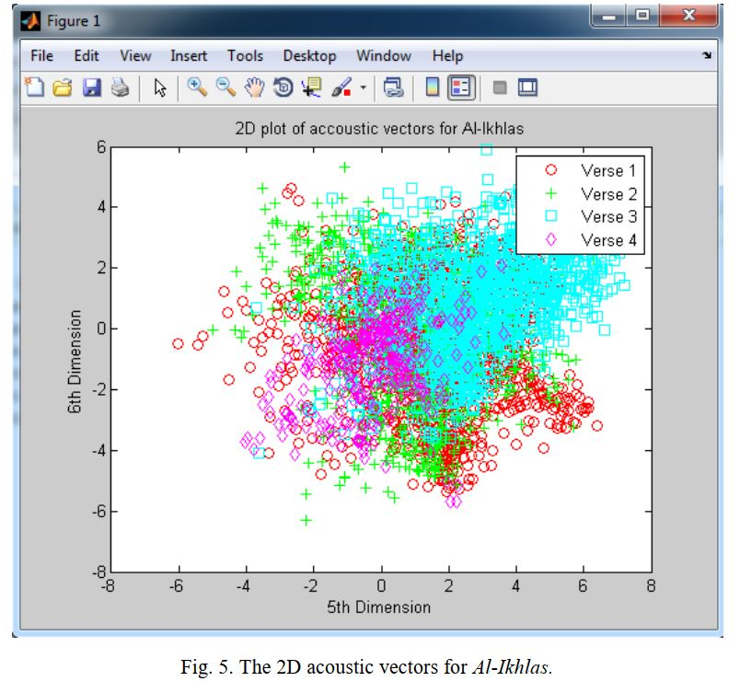
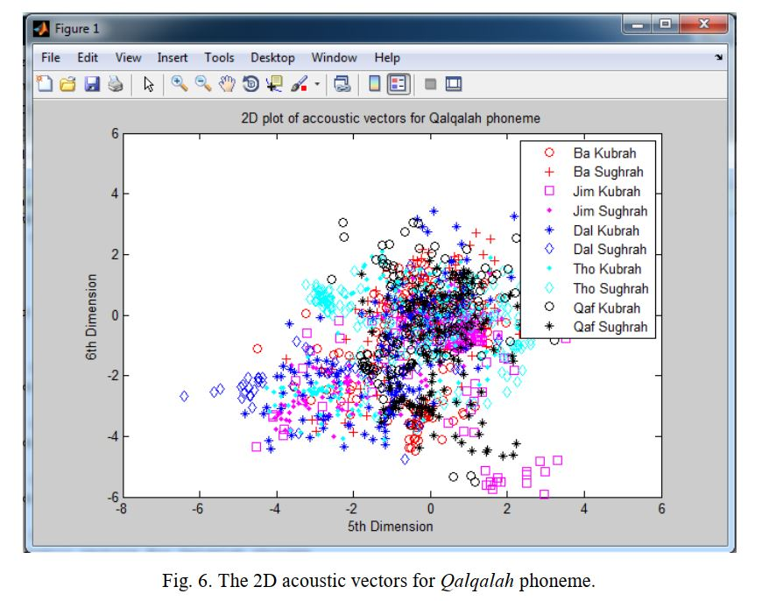
Acoustic model plotting:

Slide 33
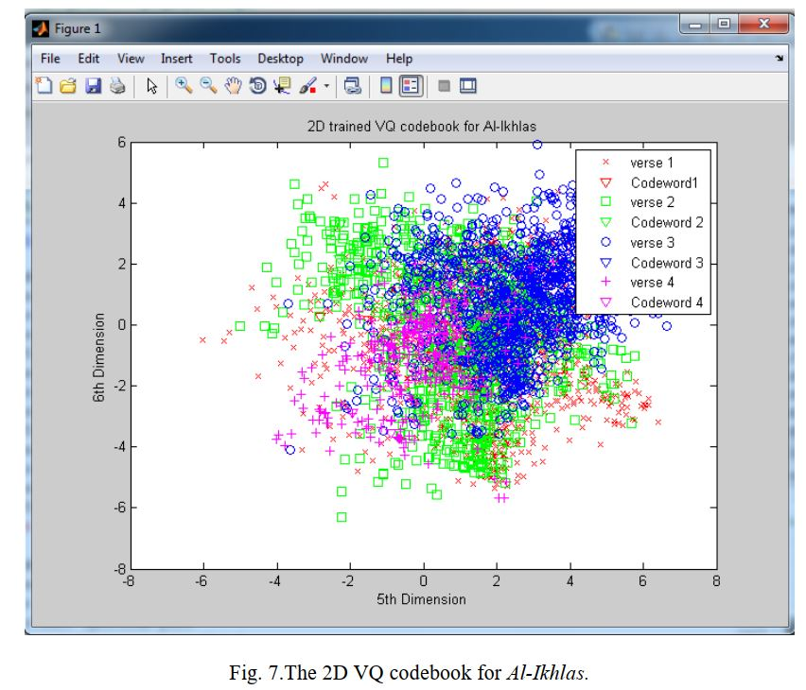
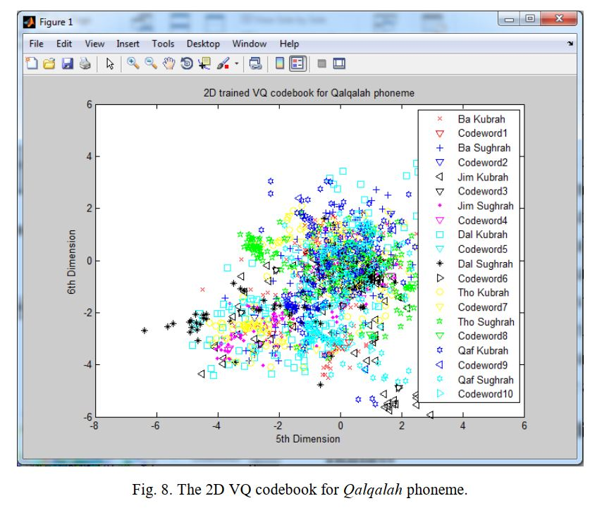
2D VQ codebook :

Slide 34
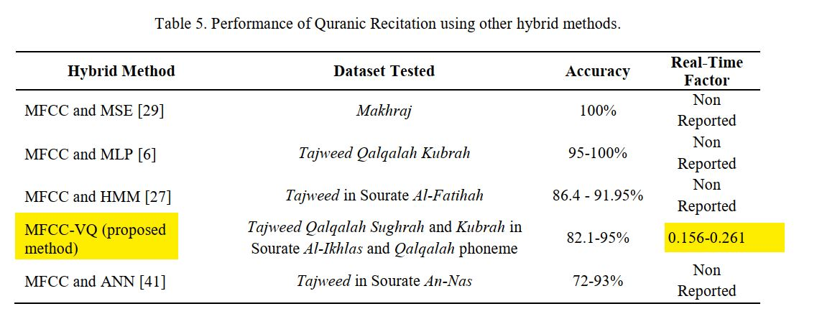
Paper 5:previous related work

Slide 35
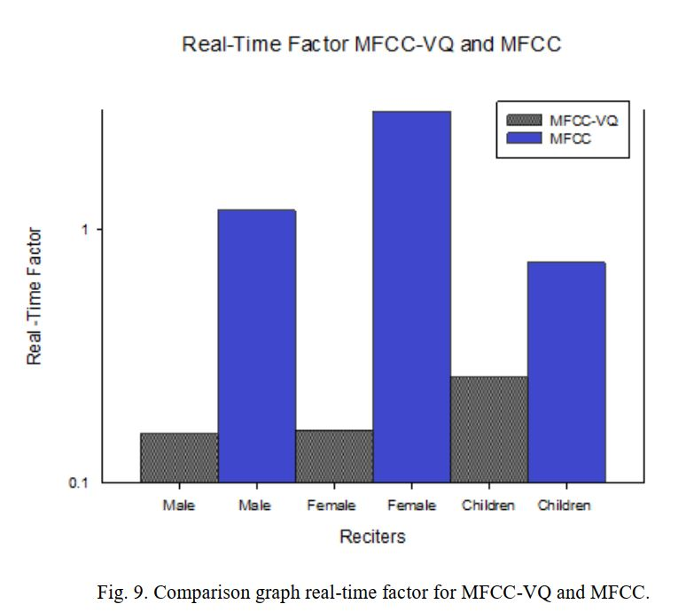
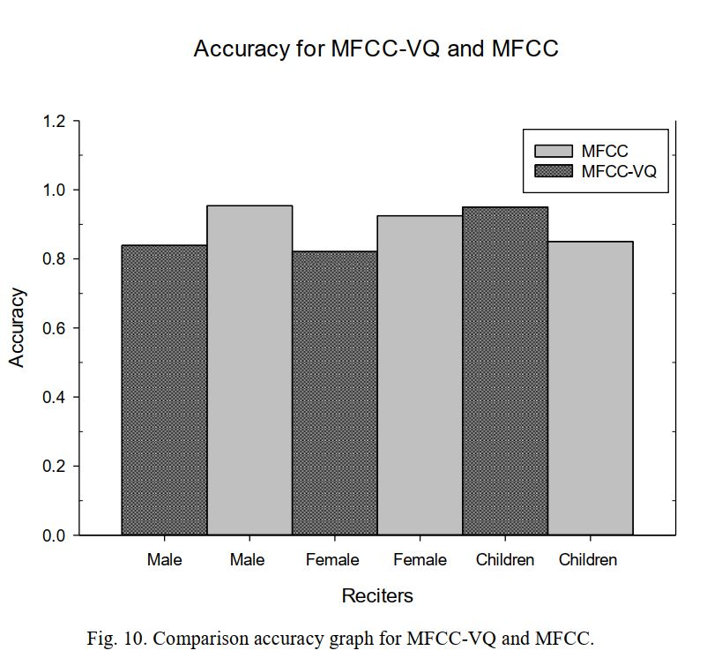
Paper 5: (Results)
Faster by 86.928% for male, 94.495% for female and 64.683% for children🡪 real-time factor.
Accuracy achieved was 83.9%, 82.1%, and 95.0%.(for males, females, children)
Can be used in recognition of Qalqalah Sughrah and Kubrah for males, females, children.
MFCC-VQ better than the MFCC in terms of speed performance.

Slide 36
Paper 6: Speaker-dependent live Quranic verses recitation recognition system using Sphinx-4 framework
Development of speaker dependent Quranic recitation recognition system.
Used (CMU) Sphinx-4 based on HMM.
Published: Dec,2014
To recognize and evaluate of recitation of some verses of Quran.
Data: from expert reciters and from users too. (Training Data)
CMU used on English language 🡪so transliteration mechanism for the Arabic language.
This system tested with 4 different ways🡪 Arabic word with Arabic alphabets, transliteration word with syllable, transliteration compound word with syllable, transliteration syllable with syllable.

Slide 37
Paper 6: (Results)
Accuracy:
-67% for Arabic word with Arabic alphabets.
-96% transliteration word with syllable.
-94% transliteration compound word with syllable.

Slide 38
Paper 7: Automated tajweed checking rules engine for Quranic learning
Developed an engine for recitation rules of Quran for the purpose of helping students to read Quran well with Tajweed rules.
Developed software, tested on primary students in Malaysia.
Provide interactive method of learning.
The input of the system is the speech signal and phonetic transcription of the speech utterance.
Students read Quran, their recitation is processed and revised and corrected by the system in real time.
Used MFCC in features extraction , Hidden Markov Model (HMM ) in classification.
Training Data: (Surat Al-Fatihah)

Slide 39
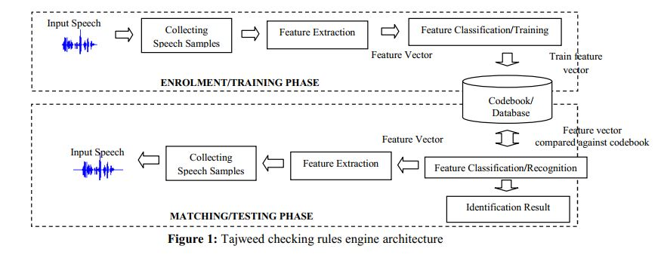
The whole system:
-Feature vector of output is compared to codebook.
-Score is obtained to evaluate the recitation.

Slide 40
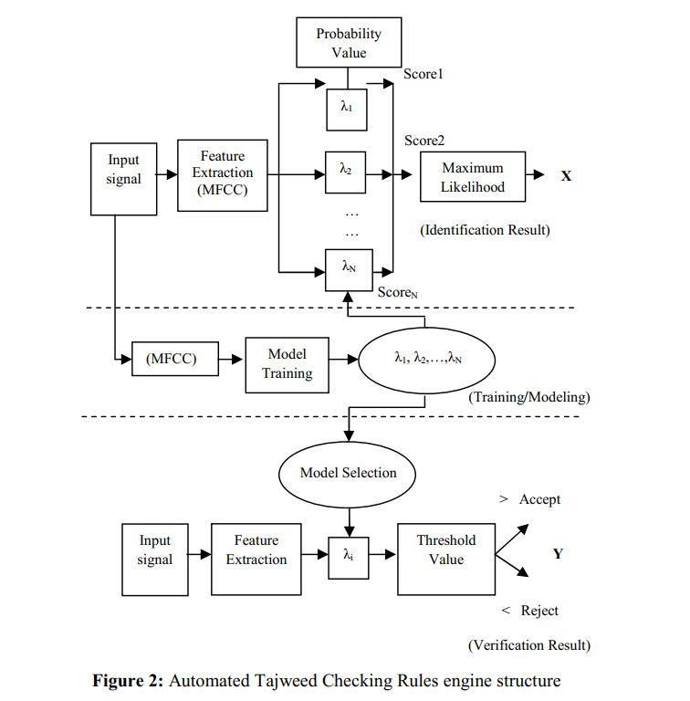
Recognition task:
Two Parts:
1-Identification:
Words recognized from observation vector of feature analysis of words.
The word selected which has highest probability, (Maximum Likelihood)
2-Verification:
Input feature is compared to stored database and threshold is used to verify if recitation is correct or wrong.

Slide 41
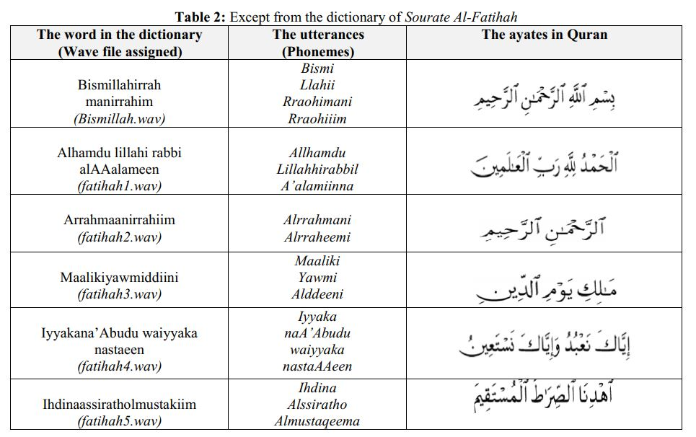
Paper 7: data
-5 different reciters.
-52 Ayates,82 probable samples of phonemes for all Quranic collected samples.

Slide 42
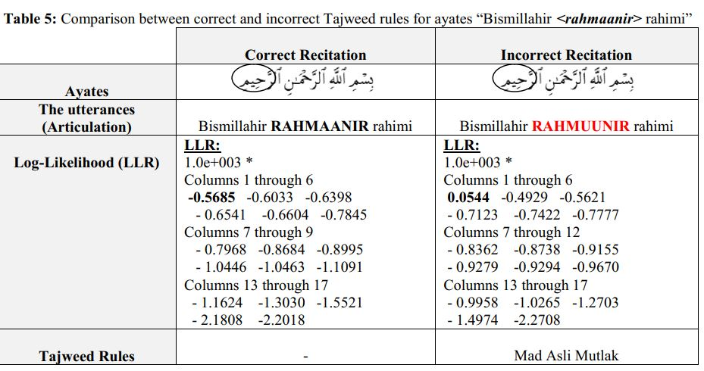
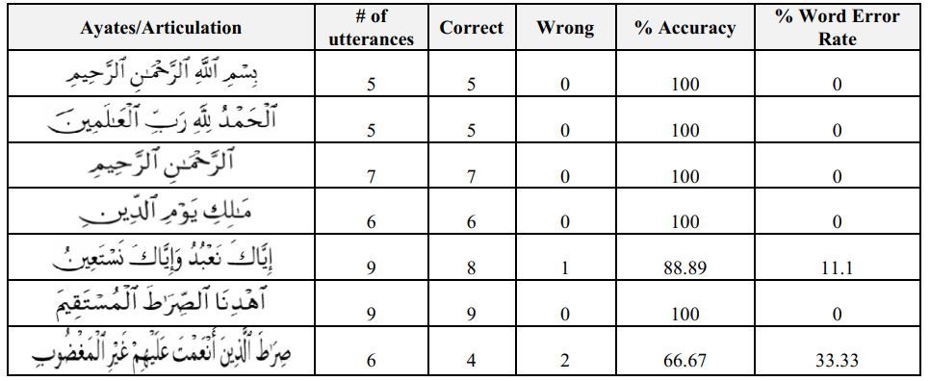
Paper 7: (Test/Matching stage)
1-Word(ayates) like-Template: Extracted features of 8 ayates of Sourate Al-Fatihah (compared to the Word-based Templates) is perfectly reached to 91.95%, 8.05% WER
2-Phonemes like-Template:
Accuracy : 86%

Slide 43
Paper :7 (Results)
Two references model were developed during this training process, which are Word based Model and Phoneme based Model .
Performance/recognition rate: -91.95% for Ayates
-86.41% for Phonemes
Better results in (Ayates) than (Phonemes):
Might because of the complexity in pronouncing the certain ayates, as well as difficulties in matching and recognizing the exact utterance properly.

Slide 44
Paper 8: Quranic Reciter Recognition: A Machine Learning Approach
Published:2019,Publishers from colleges in Saudi Arabia
They used database of 12 reciters of Quran, reading the last 10 Surah of Quran
120 Quranic recitations.
Each reciter represent a class so total classes is 12.
Audio Representation:1-Analysed in frequency domain 2-Treated as images through spectrogram
Feature Extraction: 1-MFCC 2- Auto-correlogram
Classification: Naïve Bayes,J48,Random Forest

Slide 45
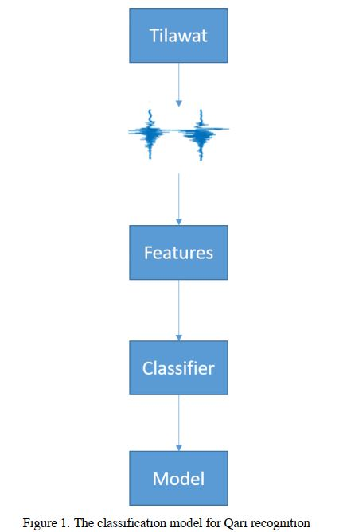
THE GENERAL MODEL:

Slide 46
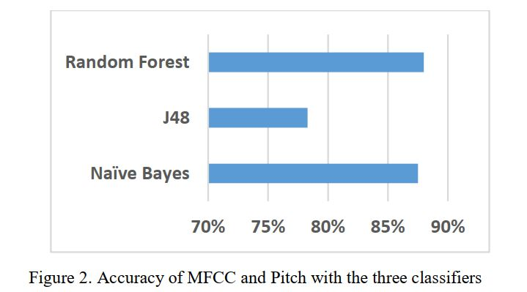
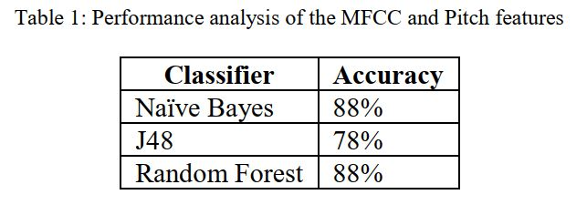
Paper 8: results
Performance analysis of the MFCC and Pitch features with the three classifiers.

Slide 47
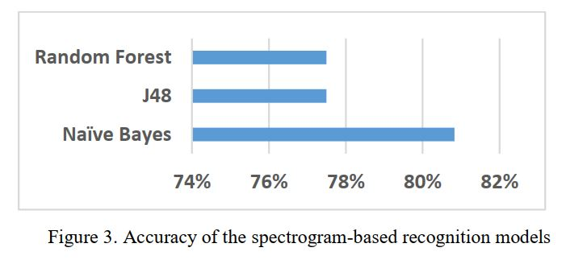
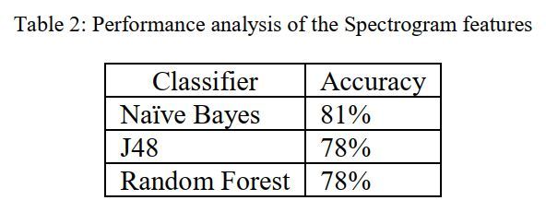
Paper 8: results (cont.)
Performance analysis of the spectrogram-based recognition in the three classifiers/models.

Slide 48
Conclusion:
Automatic speech recognition is an open area of research now on Arabic language ,specially on Holy Quran.
Recognition of Quran Recitation is an important thing so more research and work in this topic is still needed.
There are several previous work in this topic with promising results.
Different methodologies, Different models are implemented.
There are advantages and drawbacks of each models but some of them achieve better results than others.

Slide 49
References:
https://arxiv.org/abs/2101.04200
https://www.researchgate.net/publication/291155414_E-Hafiz_Intelligent_System_to_Help_Muslims_in_Recitation_and_Memorization_of_Quran
https://www.researchgate.net/publication/326010238_Using_Deep_Learning_for_Automatically_Determining_Correct_Application_of_Basic_Quranic_Recitation_Rules
https://www.researchgate.net/publication/303913944_Towards_Using_CMU_Sphinx_Tools_for_the_Holy_Quran_Recitation_Verification
https://www.researchgate.net/publication/279113646_MFCC-VQ_approach_for_Qalqalah_Tajweed_rule_checking
https://ieeexplore.ieee.org/document/7097361
https://www.researchgate.net/publication/262069927_Automated_Tajweed_Checking_Rules_Engine_for_Quranic_Learning
https://www.astesj.com/publications/ASTESJ_040621.pdf

